Slide 1
Who Should I Cite?
Learning Literature Search Models from Citation Behavior
CIKM’10
Advisor：Jia Ling, Koh
Speaker：SHENG HONG, CHUNG

Slide 2
Outline
Introduction
Features
Similar terms
Cited information
Regency
Cited using similar terms
Similar topics
Social habits
Experiment
Conclusion

Slide 3
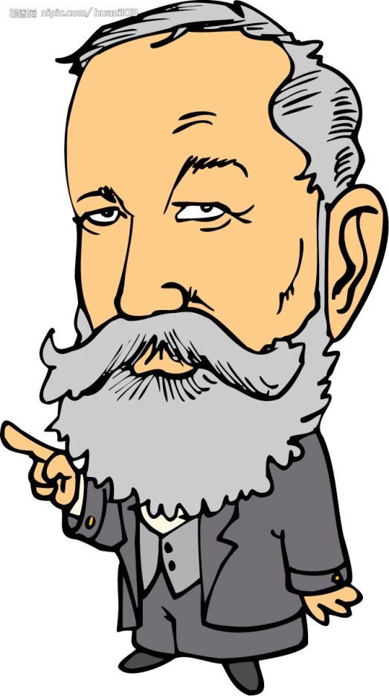
Introduction
Motivation
Article
reference
？

Slide 4
Framework of the system
Input
Output
q<-term(topic)+term(abstract)
topic
reference list
abstract
d₁
d₂
d₃
.
.
.
.
System
q

Slide 5
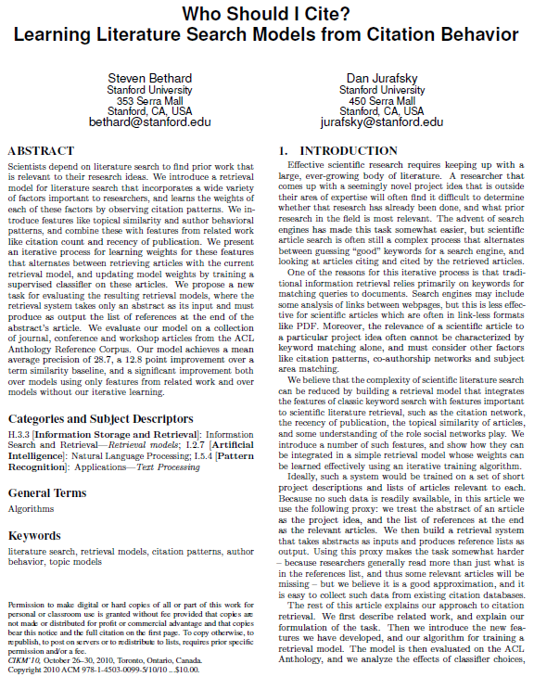
Pattern from article

Slide 6
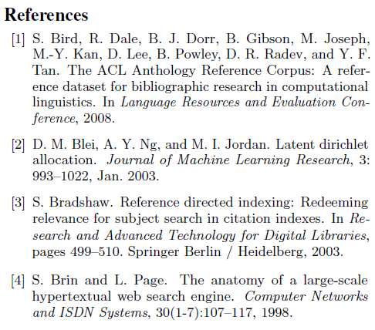
Pattern from article

Slide 7
Example
Corpus
D₁
D₂
D₃
D₄
D₅
Author: a₁ a₂
Venue: CIKM
Context:
{t₁:3,t₂:2,t₃:1}
total: 6
D₂
D₃
D₄
Author: a₁ a₃
Venue: CIKM
Context:
{t₁:2,t₂:2}
total:4
D₁
D₅
Author: a₁ a₂ a₃
Venue: CIKM
Context:
{t₁:3,t₃:1}
total:4
D₁
D₂
D₄
Author: a₂ a₃
Venue: SIGIR
Context:
{t₂:4,t₄:2}
total:6
D₂
D₃
D₅
Author: a₄
Venue: SIGIR
Context:
{t₄:3,t₅:2}
total:5
D₁
D₂

Slide 8
Similar terms
Corpus
query( topic )
D₁
D₂
D₃
D₄
D₅
.
.
.
.
abstract
TF-IDF score : topic terms and abstract terms match against document contexts
Score_{terms}(q,D₁)
Score_{terms}(q,D₂)
Score_{terms}(q,D₃)
….

Slide 9
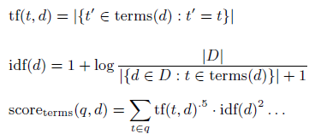
D₁
D₂
D₃
D₄
D₅
Author: a₁ a₂
Venue: CIKM
Context:
{t₁:3,t₂:2,t₃:1}
total: 6
D₂
D₃
D₄
Author: a₁ a₃
Venue: CIKM
Context:
{t₁:2,t₂:2}
total:4
D₁
D₅
Author: a₁ a₂ a₃
Venue: CIKM
Context:
{t₁:3,t₃:1}
total:4
D₁
D₂
D₄
Author: a₂ a₃
Venue: SIGIR
Context:
{t₂:4,t₄:2}
total:6
D₂
D₃
D₅
Author: a₄
Venue: SIGIR
Context:
{t₄:3,t₅:2}
total:5
D₁
D₂
query : t₁, t₂
Score_{terms}(q,D₁)
= 3^{0.5}*(1+log(5/(3+1)))²+2^{0.5}*(1+log(5/(3+1)))²
= 2.084 + 1.702 = 3.786
Score_{terms}(q,D₄)
= 0 + 4^{0.5}*(1+log(5/(3+1)))²
= 2.406
f₁:

Slide 10
Cited information
D₁
D₂
D₃
D₄
D₅
Author: a₁ a₂
Venue: CIKM
Context:
{t₁:3,t₂:2,t₃:1}
total: 6
D₂
D₃
D₄
Author: a₁ a₃
Venue: CIKM
Context:
{t₁:2,t₂:2}
total:4
D₁
D₅
Author: a₁ a₂ a₃
Venue: CIKM
Context:
{t₁:3,t₃:1}
total:4
D₁
D₂
D₄
Author: a₂ a₃
Venue: SIGIR
Context:
{t₂:4,t₄:2}
total:6
D₂
D₃
D₅
Author: a₄
Venue: SIGIR
Context:
{t₄:3,t₅:2}
total:5
D₁
D₂
According to the feature from corpus :
citing(D₁) = {D₂D₃D₅}
|citing (D₁) |= 3 = score_{citation-count}(q,D₁)
citing(D₂) = {D₁D₃D₄D₅}
|citing (D₂) |= 4 = score_{citation-count}(q,D₂)
citing(D₃) = {D₁D₄}
|citing (D₃) |= 2 = score_{citation-count}(q,D₃)
citing(D₄) = {D₁D₃}
|citing (D₄) |= 2 = score_{citation-count}(q,D₄)
citing(D₅) = {D₂D₄}
|citing (D₅) |= 2 = score_{citation-count}(q,D₅)
f₂:

Slide 11
D₁
D₂
D₃
D₄
D₅
Author: a₁ a₂
Venue: CIKM
Context:
{t₁:3,t₂:2,t₃:1}
total: 6
D₂
D₃
D₄
Author: a₁ a₃
Venue: CIKM
Context:
{t₁:2,t₂:2}
total:4
D₁
D₅
Author: a₁ a₂ a₃
Venue: CIKM
Context:
{t₁:3,t₃:1}
total:4
D₁
D₂
D₄
Author: a₂ a₃
Venue: SIGIR
Context:
{t₂:4,t₄:2}
total:6
D₂
D₃
D₅
Author: a₄
Venue: SIGIR
Context:
{t₄:3,t₅:2}
total:5
D₁
D₂
D₃
D₂
More in-links, more important
Take friendship as an example :
A has 5 friends, all of them are normal people
B has 5 friends, but all of them are famous people
B is more important than A
How to tell normal and famous? pagerank
D₁
D₄
D₅

Slide 12
D₃
D₂
D₁
D₄
D₅
Score_{pagerank}(q,D₁) = 0.15/5 +
0.85 * (Score_{pagerank}(q,D₂) /2 + Score_{pagerank}(q,D₃) /3+ Score_{pagerank}(q,D₅) /2)
f₃:
Notes:
原來PAGERANK的概念是要去評估搜尋引擎回傳網頁的重要性，重要網頁放到前面，怎樣評估?
CORPUS裡面互列，形成社交網絡
先不管NODE重不重要，看誰指向他，
越多NODE指到我，代表較為重要，REFERNCE到我，代表覺得我重要，本來是看in-link個數
接下來概念
20個朋友連到他，路人
有名人連到他，有名人都還需要reference他這個較為重要
每個NODE本身自己有分數，分數是人家指到他的個數
有不有名怎樣評估
每一個node給初始分數
重複下去計算
分數就是指進去的分數，彼此貢獻來貢獻去，最後收斂的話表示pagerank分數較高
整個網絡之中重要程度
Matrix計算重複的計算

Slide 13
D₁
D₂
D₃
D₄
D₅
Author: a₁ a₂
Venue: CIKM
Context:
{t₁:3,t₂:2,t₃:1}
total: 6
D₂
D₃
D₄
Author: a₁ a₃
Venue: CIKM
Context:
{t₁:2,t₂:2}
total:4
D₁
D₅
Author: a₁ a₂ a₃
Venue: CIKM
Context:
{t₁:3,t₃:1}
total:4
D₁
D₂
D₄
Author: a₂ a₃
Venue: SIGIR
Context:
{t₂:4,t₄:2}
total:6
D₂
D₃
D₅
Author: a₄
Venue: SIGIR
Context:
{t₄:3,t₅:2}
total:5
D₁
D₂
D₁
D₂
D₃
citing(D₁) = {D₂D₃D₅}
score_{venue-citation-count}(q,D₁) = 3 + 4 + 2 = 9
score_{venue-citation-count}(q,D₄) = 2 + 2 = 4
a₁:{D₁,D₂,D₃}
citing(D₂) = {D₁D₃D₄D₅}
score_{author-citation-count}(q,D₁) = max{9,7} = 9
a₂:{D₁,D₃,D₄}
citing(D₃) = {D₁D₄}
score_{author-citation-count}(q,D₅) = max{2} = 2
citing(D₄) = {D₁D₃}
f₄:
citing(D₅) = {D₂D₄}
f₅:
Notes:
有被人家cite總次數+起來

Slide 14
h-index
Definition :
An author has published h papers each of which has been cited by others at least h times
Sort cited count
Example :
D₈(600)
D₁₀(10)
D₃(10)
D₂(10)
D₁(10)
D₄(6)
D₅(3)
D₆(2)
D₇(2)
D₉(2)
D₈(600)
D₁₀(10)
D₃(10)
D₂(10)
D₁(10)
D₄(5)
D₅(3)
D₆(2)
D₇(2)
D₉(2)
h-index = 6
h-index = 5

Slide 15
D₁
D₂
D₃
D₄
D₅
Author: a₁ a₂
Venue: CIKM
Context:
{t₁:3,t₂:2,t₃:1}
total: 6
D₂
D₃
D₄
Author: a₁ a₃
Venue: CIKM
Context:
{t₁:2,t₂:2}
total:4
D₁
D₅
Author: a₁ a₂ a₃
Venue: CIKM
Context:
{t₁:3,t₃:1}
total:4
D₁
D₂
D₄
Author: a₂ a₃
Venue: SIGIR
Context:
{t₂:4,t₄:2}
total:6
D₂
D₃
D₅
Author: a₄
Venue: SIGIR
Context:
{t₄:3,t₅:2}
total:5
D₁
D₂
citing(D₁) = {D₂D₃D₅}
f₆:
citing(D₂) = {D₁D₃D₄D₅}
a₁:{D₁,D₂,D₃}
a₂:{D₁,D₃,D₄}
citing(D₃) = {D₁D₄}
D₂(4)
D₁(3)
D₃(2)
D₁(3)
D₃(2)
D₄(2)
citing(D₄) = {D₁D₃}
citing(D₅) = {D₂D₄}
h-index = 2
h-index = 2
score_{author-h-index}(q,D₁) = max{2,2} = 2
15

Slide 16
D₁
D₂
D₃
D₄
D₅
Author: a₁ a₂
Venue: CIKM
Context:
{t₁:3,t₂:2,t₃:1}
total: 6
Year:2007
D₂
D₃
D₄
Author: a₁ a₃
Venue: CIKM
Context:
{t₁:2,t₂:2}
total:4
Year:2008
D₁
D₅
Author: a₁ a₂ a₃
Venue: CIKM
Context:
{t₁:3,t₃:1}
total:4
Year:1988
D₁
D₂
D₄
Author: a₂ a₃
Venue: SIGIR
Context:
{t₂:4,t₄:2}
total:6
Year:2003
D₂
D₃
D₅
Author: a₄
Venue: SIGIR
Context:
{t₄:3,t₅:2}
total:5
Year:2002
D₁
D₂
Year:2009
score_{age}(q,D₁) = -(2009-2007) = -2
query( topic )
score_{age}(q,D₃) = -(2009-1988) = -21
f₇:
─(
)

Slide 17
Cited using similar terms
D₁
D₂
D₃
D₄
D₅
Author: a₁ a₂
Venue: CIKM
Context:
{t₁:3,t₂:2,t₃:1}
total: 6
Year:2007
D₂
D₃
D₄
Author: a₁ a₃
Venue: CIKM
Context:
{t₁:2,t₂:2}
total:4
Year:2008
D₁
D₅
Author: a₁ a₂ a₃
Venue: CIKM
Context:
{t₁:3,t₃:1}
total:4
Year:1988
D₁
D₂
D₄
Author: a₂ a₃
Venue: SIGIR
Context:
{t₂:4,t₄:2}
total:6
Year:2003
D₂
D₃
D₅
Author: a₄
Venue: SIGIR
Context:
{t₄:3,t₅:2}
total:5
Year:2002
D₁
D₂
TF-IDF + cited information
citing(D₁) = {D₂D₃D₅}
score_{term-citing}(q,D₁)
= score_{terms}(q,concat(term(D₂),term(D₃),term(D₅)))
citing(D₂) = {D₁D₃D₄D₅}
citing(D₃) = {D₁D₄}
f₈:
citing(D₄) = {D₁D₃}
citing(D₅) = {D₂D₄}

Slide 18
score_{term-citing}(q,D₁)
D₁
D₂D₃D₅
q
D
D’
cite
Too many terms
Stopwords
TF-IDF
Assume that there are
k documents in corpus
New data set
pmi(t_{1~n},D₁)
text_{pmi}(D₁)
{D₁~D_{m}}
{t₁~t_{n}}
pmi(t_{1~n},D₂)
text_{pmi}(D₂)
.
.
.
pmi(t_{1~n},D_{k})
text_{pmi}(D_{k})
Collect m documents (m<k) cited at least five times
and terms that occur at least twice

Slide 19
D₁
D₂
D₃
D₄
D₅
pmi(x,y) $=p\left(x,y\right)∗log\frac{p(x,y)}{p\left(x\right)p(y)}$
pmi(x,y) $=log\frac{p(x,y)}{p\left(x\right)p(y)}$
Author: a₁ a₂
Venue: CIKM
Context:
{t₁:3,t₂:2,t₃:1}
total: 6
Year:2007
D₂
D₃
D₄
Author: a₁ a₃
Venue: CIKM
Context:
{t₁:2,t₂:2}
total:4
Year:2008
D₁
D₅
Author: a₁ a₂ a₃
Venue: CIKM
Context:
{t₁:3,t₃:1}
total:4
Year:1988
D₁
D₂
D₄
Author: a₂ a₃
Venue: SIGIR
Context:
{t₂:4,t₄:2}
total:6
Year:2003
D₂
D₃
D₅
Author: a₄
Venue: SIGIR
Context:
{t₄:3,t₅:2}
total:5
Year:2002
D₁
D₂
Assume that p(x) = 1/2 p(y) = 1/2
If p(x,y) > 1/4 positive correlation
If p(x,y) = 1/4 x and y are independent
If p(x,y) < 1/4 negative correlation
citing(D₁) = {D₂D₃D₅}
citing(D₂) = {D₁D₃D₄D₅}
pmi(t₁,D₁) = log (p_{termciting}(t₁,D₁) / p_{term}(t₁)p_{citing}(D₁))
citing(D₃) = {D₁D₄}
citing(D₄) = {D₁D₃}
citing(D₅) = {D₂D₄}
p_{term}(t₁) = (3+2+3)/(6+4+4+6+5 ) = 8/25

Slide 20
D₁
D₂
D₃
D₄
D₅
Author: a₁ a₂
Venue: CIKM
Context:
{t₁:3,t₂:2,t₃:1}
total: 6
Year:2007
D₂
D₃
D₄
Author: a₁ a₃
Venue: CIKM
Context:
{t₁:2,t₂:2}
total:4
Year:2008
D₁
D₅
Author: a₁ a₂ a₃
Venue: CIKM
Context:
{t₁:3,t₃:1}
total:4
Year:1988
D₁
D₂
D₄
Author: a₂ a₃
Venue: SIGIR
Context:
{t₂:4,t₄:2}
total:6
Year:2003
D₂
D₃
D₅
Author: a₄
Venue: SIGIR
Context:
{t₄:3,t₅:2}
total:5
Year:2002
D₁
D₂
f₉:
p_{citing}(D₁) = 3/(3+4+2+2+2)= 3/13
citing(D₁) = {D₂D₃D₅}
citing(D₂) = {D₁D₃D₄D₅}
citing(D₃) = {D₁D₄}
citing(D₄) = {D₁D₃}
citing(D₅) = {D₂D₄}
p_{termciting}(t₁,D₁) = (2+3)/(13+21+12+10+10) = 5/66
pmi(t₁,D₁) = log(5/66 / (8/25*3/13)) = 0.011

Slide 21
Latent Dirichlet Allocation
Document
Topic 1
Topic 2
Topic N
……
……
Word 1
Word 2
Word M
……
……

Slide 22
Assume 3 topics{ algorithm, performance, running time }
topics(q) = {4/6,1/6,1/6}
topics(D₁)={1/4,1/4,1/2}
f₁₀:
score_{topics}(q,D₁) = cos(topics(q),topics(D₁)) = 0.67
f₁₁:
citing(D₁) = {D₂,D₃}
topics(D₂)={1/6,1/6,4/6}
topics(K)=1/2 * {5/12,2/3,11/12}
topics(D₃)={1/4,1/2,1/4}
Score_{topics-citing}(q,D₁) = cos(topics(q),topics(K))

Slide 23
Assume 3 topics{ algorithm, performance, running time }
f₁₂:
topics(q) = {4/6,1/6,1/6}
topics(D₁)={1/4,1/4,1/2}
toptopic(q) = 1
citing(D₁) = {D₂,D₃}
topics(D₂)={4/6,1/6,1/6}
toptopic(D₂) = 1
topics(D₃)={1/4,1/2,1/4}
toptopic(D₃) = 2
score_{topic-citation-count}(q,D₁) = 1
f₁₃:
f₁₄:
score_{topic-entropy}(q,D₁) = -(1/4*log(1/4)+1/4*log(1/4)+1/2*log(1/2))

Slide 24
Social Habits
D₁
D₂
D₃
D₄
D₅
Author: a₁ a₂
Venue: CIKM
Context:
{t₁:3,t₂:2,t₃:1}
total: 6
Year:2007
D₂
D₃
D₄
Author: a₁ a₃
Venue: CIKM
Context:
{t₁:2,t₂:2}
total:4
Year:2008
D₁
D₅
Author: a₁ a₂ a₃
Venue: CIKM
Context:
{t₁:3,t₃:1}
total:4
Year:1988
D₁
D₂
D₄
Author: a₂ a₃
Venue: SIGIR
Context:
{t₂:4,t₄:2}
total:6
Year:2003
D₂
D₃
D₅
Author: a₄
Venue: SIGIR
Context:
{t₄:3,t₅:2}
total:5
Year:2002
D₁
D₂
Authors like to cite the paper written by him
query
score_{authors}(q,D₁) = score_{terms}(authors(q),authors(D₁))
= tf(a₁)*idf(a₁)+tf(a₂)*idf(a₂)
= 1*(1+log(5/(3+1))) + 1*(1+log(5/(3+1)))
Author: a₁ a₂
f₁₅:

Slide 25
Social Habits
D₁
D₂
D₃
D₄
D₅
Author: a₁ a₂
Venue: CIKM
Context:
{t₁:3,t₂:2,t₃:1}
total: 6
Year:2007
D₂
D₃
D₄
Author: a₁ a₃
Venue: CIKM
Context:
{t₁:2,t₂:2}
total:4
Year:2008
D₁
D₅
Author: a₁ a₂ a₃
Venue: CIKM
Context:
{t₁:3,t₃:1}
total:4
Year:1988
D₁
D₂
D₄
Author: a₂ a₃
Venue: SIGIR
Context:
{t₂:4,t₄:2}
total:6
Year:2003
D₂
D₃
D₅
Author: a₄
Venue: SIGIR
Context:
{t₄:3,t₅:2}
total:5
Year:2002
D₁
D₂
If author cited the document before
query
citing(D₁) = {D₂D₃D₅}
Author: a₁ a₂
score_{author-cited-article}(q,D₁) = score_{terms}(authors(q) ,concat(authors(D₂),authors(D₃),authors(D₅)))
= 2*1+log(5/(3+1))+1*(1+log(5/(3+1)))
citing(D₂) = {D₁D₃D₄D₅}
citing(D₃) = {D₁D₄}
citing(D₄) = {D₁D₃}
f₁₆:
citing(D₅) = {D₂D₄}

Slide 26
Social Habits
score_{author-cited-article}(q,D₁)
Don’t care D₁ author
D₁
citing(D₁)={D₂,D₃,D₅}
q
D
D’
cite
score_{author-cited-author}(q,D₁)
Care D₁ author
citing(D₁),citing(D₂),
citing(D₃),citing(D₄)
D₁D₂D₃D₄
f₁₇:
q
D
cite
D’

Slide 27
Social Habits
score_{author-cited-venue}(q,D₁)
fix D₁ venue
D₁D₂D₃
citing(D₁),citing(D₂),citing(D₃)
q
D
D’
cite
f₁₈:

Slide 28
Social Habits
Score_{authors-coauthored}(q,D₁)
D₁D₂D₃D₄
q
D
{a₁,a₂}
{a₃,a₄}
f₁₉:

Slide 29
Weighted sum
Combined all features by weighted sum
Compress scale

Slide 30
Experiment
Precision
Average precision
Mean average precision

Slide 31
Precision / Recall
Precision = Relevant Documents Retrieved / Total Retrieved Documents
Recall = Relevant Documents Retrieved / Total Relevant Documents
Example :
Dataset : 10000 data
500 data related to dining food
User gives a query “dining food ”, system retrieves 4000 data, 400 data related to dining food
Precision = 400/4000
Recall = 400/500

Slide 32
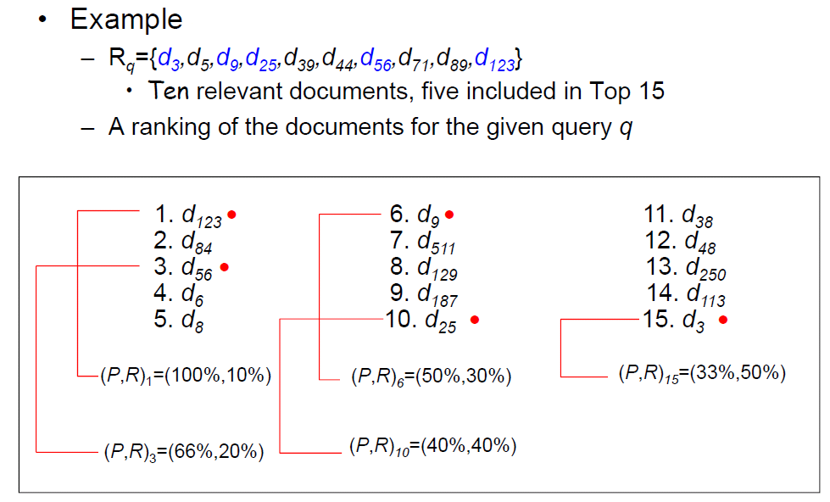

Slide 34
Q₁
Retrieval documents
System
Average precision
.
.
.
.
.
.
Q₁₆
Retrieval documents
System
Average precision
MAP = (Q₁+Q₂+…+Q₁₆) / 16

Slide 35
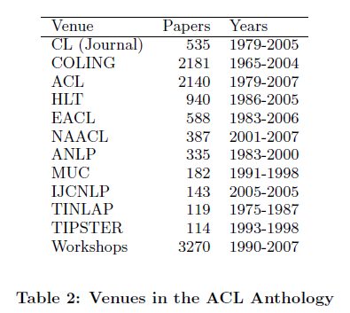
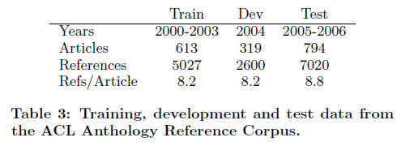
Experiment

Slide 36
Experiment
Who Should I Cite?
topic
+
abstract
reference list
System
retrieve
D₁
D₅
D₃
D₄
reference
D₁
D₂
D₃
D₄
MAP

Slide 37
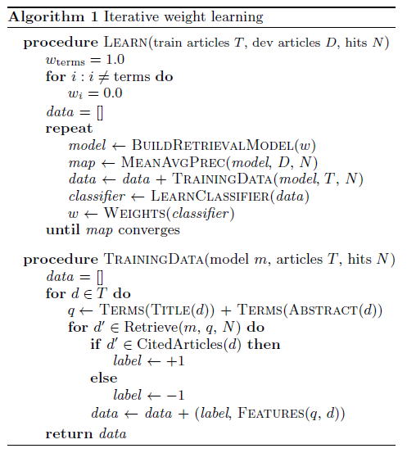
score(q,d)
= w₁*f₁+w₂*f₂+…+w₁₉*f₁₉
w₁ = 1, w₂~w₁₉=0
score(q,d) = w₁*f₁
D₁
D₂
D₃
.
.
Model
+
weight
Retrieve
documents
Calculate
MAP
Development
data
D₁
D₅
D₃
.
.

Slide 38
MEANAVGPREC(model, D, N)
{
for(D)
{
q<-TERMS(TITLE(D))+TERMS(ABS)
d’<-Retrieve(m,q,N)
MAP<-calMAP(citedarticles(D),d’)
}
return MAP;
}

Slide 39
data = []
put q into model m( w₁=1, else = 0)
Get retrieval documents d’
Training data d
ref
S
If d’ ∈ S, label = 1
Else label = -1
data update,
using classifier to adjust weights
Iterative procedure

Slide 40
Experiment

Slide 41
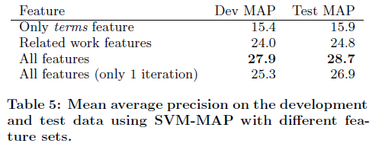
Experiment
Related work features :
terms, citation-count, pagerank, age, term-citing, authors

Slide 42
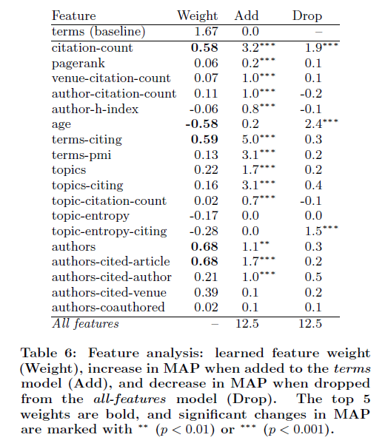
Experiment

Slide 43
Conclusion
Present a model for scientific article retrieval that introduces new features and new learning algorithm.
Show that the weights for these features can be more efficiently learned by an iterative procedure.

